Slide 1


Chapter Two
Chapter Two
Database System Concepts and Architecture
Database System Concepts
and Architecture

Slide 2

Objectives of the chapter
Overview of Data Models, Schema and Instances
Understand the DBMS Architecture and Data Independence
Describe the Database Language and Interface
Learn about The Database System Environment
List out each of Classification of DBMS

Slide 3
Database System Concepts and Architecture
One of the main characteristics of the database approach is that it provides some levels of data abstraction.
A data model is a collection of concepts that can be used to describe the structure of a database to achieve the data abstraction.
The structure of a database means the data types, relationships, and constraints that should hold for the data.
It is a description of the way that data is stored in a database.
Most data models also include a set of basic operations for specifying retrievals, insertion and updates on the database.

Slide 4
Categories of data models
Many data models have been proposed, which can be categorized according to the types of concepts they use to describe the database structure.
A set of concepts to describe the structure and constraints of a database.
Describing
Data
Data relationship
Data semantics
Data constraints
Categories of data models
Object-based
Record-based
Physical

Slide 5
Cont..
An entity represents a real-world object or concept such as an employee that is described in the database.
An attribute represents some property of interest that further describes an entity, such as employee’s name or employee’s salary.
A relationship among two or more entities represents an association among 2 or more entities.
Eg : a work-on relationships between an employee and a project

Slide 6
Schemas, Instances and Database State
In any data model, it is important to distinguish between the descriptions of the database and the database itself.
The description of a database is called the database schema, which is specified during database design and is not expected to change frequently.
A displayed schema is called a schema diagram.
It is skeleton structure of entire database to represents the logical view of entire database.
Data type of each item, relationships among the various files and some constraints are not specified in schema diagrams.

Slide 7
Example of a Database Schema
Database schema does not contain any data or information
It is designed when database doesn't exist at all and very hard to do any changes once the database is operational.

Slide 8
Cont.…
Database instances, is a state of operational database with data at any given time.
The data in the database at a particular moment is called a database state or snapshot.
The actual data in a database may change quite frequently.
It is also called current set of occurrences or instances in the database.
Whenever a new database is defined, we specify its database schema only to the DBMS.
Every time when an update operation is applied to the database, we get another database state.

Slide 9
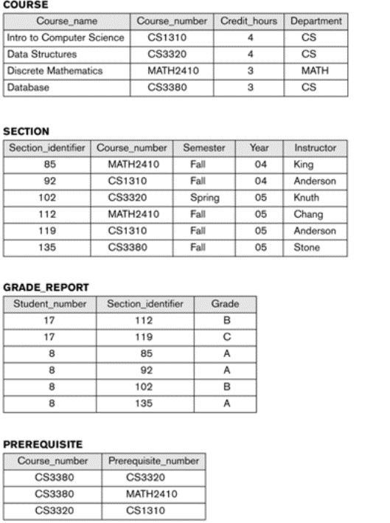
Example of a database state
The DBMS stores the description of the schema constructs and constraints- also called the meta data- in the DBMS catalog, so that DBMS software can refer to the schema whenever it needs to.
The schema is sometimes called the intention and a database state is called an extension of the schema.

Slide 10
The Three-Schema Architecture
The goal of the 3-schema architecture is to separate the user application and the physical database. In this architecture, schemas can be defined at the following 3 levels.

Slide 11
Cont..
The internal level has an internal schema, which describes the physical storage structure of the database.
The internal schema uses a physical data model and describes the complete details of the data storage and access paths for the database.
The conceptual level has a conceptual schema, which describes the structure of the whole database.
The conceptual schema hides the details of physical storage structures and concentrates on describing entities, data types, relationships, user operations, and constraints.
The external or view level includes a number of external schemas or user views.

Slide 12
Cont..
Each external schema describes the part of the database, that a particular user group is interested in and hides the rest of the database from that user group.
In a DBMS, based on 3-schema architecture, each user group refers only to its own external schema.
Hence DBMS must transform a request specified on an external schema into a request against the conceptual schema, and then into a request on the internal schema for processing over the stored database.
The process of transforming requests and results between levels are called mappings.

Slide 13
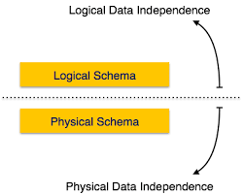
Data Independence
The capacity to change the schema at one level of a database system without changing the schema at the next higher level.
Two types of data independence
1) Logical data independence
2) Physical data independence

Slide 14
Logical data independence
Logical data independence is the capacity to change the conceptual schema without having to change the external schemas or application programs.
The changes like expanding the database, changing constraints, removing a record type or a data item, etc….
In the conceptual schema, should not be affected in the external schemas.
Only the view definition and the mappings need changes in a DBMS that supports data independence.
Physical data independence
Physical data independence is the capacity to change the internal schema without having to change the conceptual schema.
The changes like file location, access path doesn’t alter the conceptual schema.

Slide 15
DBMS Languages
Once the design of a database is completed, and a DBMS is chosen to implement the database, the first step is to specify conceptual and internal schemas for the database and any mappings between the two.
The Data Definition Languages (DDL) is used by the DBA and Database designers to define internal and conceptual schemas.
The DBMS will have a DDL compiler to process DDL statements in order to identify descriptions of the schema construct and to store the schema descriptions in the DBMS catalog.
In DBMSs, where a clear separation is maintained between the conceptual and internal levels, the DDL is used to specify the conceptual schema only.
Typical DDL include Create, Alter, Drop, and Rename of the database.

Slide 16
Cont…
Another Storage Definition Language (SDL) is used to specify the internal schema.
For a true 3-schema architecture, a View Definition Language (VDL) is needed to specify user views and their mappings to the conceptual schema.
But in most DBMSs, the DDL is used to define both conceptual and external schemas.
The DBMS provides a Data Manipulation Language (DML) for the users to manipulate the database.
Typical manipulations include retrieval, insertion, deletion, and modification of the data.
The current DBMSs, a comprehensive integrated language called the SQL relational database language represents a combination of DDL, VDL, DML and some features also.

Slide 17
Cont…
The SDL was a component in early versions of SQL, but has been removed from the language to keep it at the conceptual and external levels only.
Data Control Language: Database is a shared resource that demands control of data access and usage.
DCL are commands that will help the Database Administrator to control the database.
The commands include grant or revoke privileges to access the database.
The database administrator should have the facility to control the overall operation of the system

Slide 18
DBMS Interfaces
User friendly interfaces provided by a DBMS may include the following:-
1) Menu based Interfaces for the web clients or browsing :-These interfaces present the user with lists of options (called menus) that lead the user through the formulation of a request.
In menu based interfaces, the query is composed step-by-step by picking options from a menu that is displayed by the system.
2) Forms-Based Interfaces :-A form based interface displays a form to each user.
Users can fill out all of form entries to insert new data.
Many DBMSs have special languages called as form specification languages that help programmers to specify such forms.

Slide 19
DBMS Interfaces
3) Graphical User Interfaces (GUI) :-GUI typically displays a schema to the user in diagrammatic form.
The user then can specify a query by manipulating the diagram. In many cases, GUIs utilize both menus and forms.
4) Natural Language Interfaces:-These interfaces accept requests normally written in English.

Slide 20
Cont..
5) Speech Input and Output:-The speech input is detected using a library of predefined words and used to set up the parameters that are supplied to the queries. For output, a similar conversion from text or numbers into speech takes place.
6) Interface for the DBA:-Most database systems contain privileged commands that can be used only by the DBA’s staff. These include commands for creating accounts, setting system parameters, granting account authorization, changing a schema, and reorganizing the storage structures of a database.

Slide 21
Components of DBMS environment
The DBMS environment has five components.
Hardware: like personal computers, mainframe or any server computers, network infrastructure, and other peripherals required in the system.
Software: include DBMS software, application programs, operating systems, network software, language software and other relevant software.
Data is the most important component to the user of the database.
Operational data is the data actually stored in the system to be used by the user.
Metadata is the data that is used to store information about the database itself.
Procedure is the rules and regulations on how to design and use a database.
People: play a role in designing, implementing, managing, administering and using the resources in the database.

Slide 22
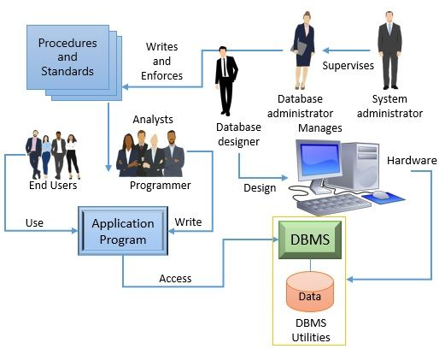
The database system Environment
The below given figure shows the general component modules of a DBMS and their interactions.

Slide 23
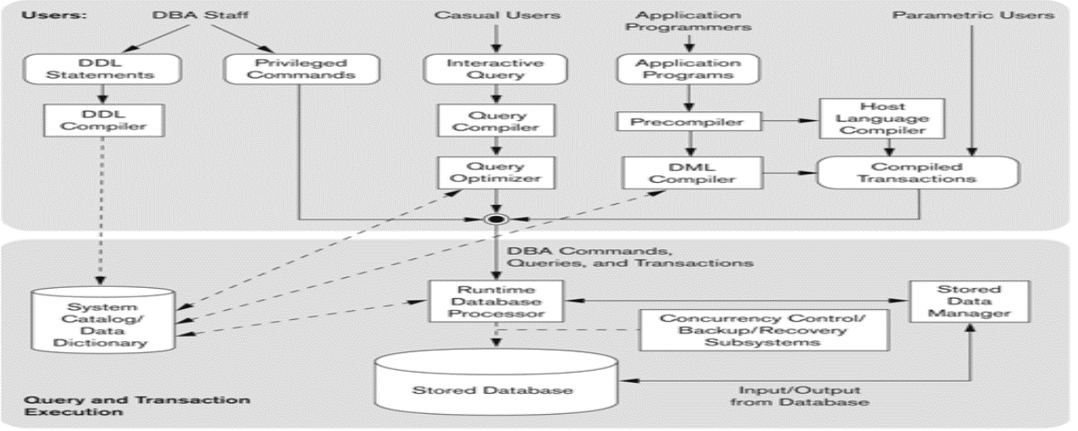
Cont.…

Slide 24
Cont..
The top half of the above figure refers to the various users of the database environment and their interfaces.
The lower half shows the internals of the DBMS responsible for storage of data and processing of transactions.
The top half shows interfaces for DBA staff, casual users who work with interactive interfaces to formulate queries, application programmers who program using some host languages and parametric users who do data entry work by supplying parameters to predefined transactions.

Slide 25
Centralized and Client/Server Architectures for DBMS
Centralized database system:
The centralized database system consist of a single processor together with it associated data storage devices and other peripherals. It is physically confined to a single location.
The data can be accessed from the multiple sites with the use of a computer network.
Disadvantages of centralized database system::
When the central site computer or database system goes down, then everyone is blocked from using the system until the system comes back. Expensive in its communication cost.
Client server dbms:
It has two logical components namely client and server.
Client is generally personal computer or workstations whereas server is large workstations, mini range computer system or a mainframe computer system.
The application and tools of DBMS run on one or more client platforms, while the DBMS software's reside on the server.

Slide 26
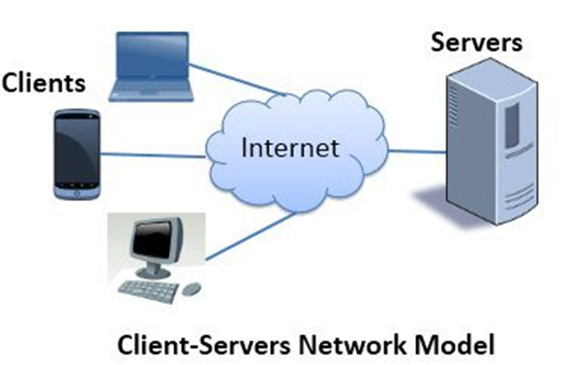
Cont.…
ADVANTAGES:
CLIENT / SERVER system has less expensive platforms to support applications.
Client/ server environment facilities in more productive work by the users and making better use of existing data.
It is more flexible as compared to the centralized systems.
A single server can be shared across several distinct client (application) system.
DISADVANTAGE:
Programming cost is high in client / server environment, particularly in initial phases.
There’s a lack of management tools for diagnosis, performance monitoring and tuning and security control, for the DBMS client and OS and networking environments.

Slide 27
Classification of DBMS
Based on the data model DBMS can be:
Relational
Object
Object-relation
Hierarchical,
Network and others
Based on the number of users supported by the DBMS, it can be:
Single-user DBMS
Multi-user DBMS
Based on the number of sites over which the database is distributed, DBMS can be:
Centralized DBMS,
Distributed DBMS

Slide 28
